Slide 1

2025 BA-Eindwerkstuk Seminar
Class #1: Developing a Research Question and Identifying the Research Problem
Workgroup 103
Dr. Steven Denney
Friday, 7 February 2025

Slide 2
Who's Who
What is your name – full and preferred?
What is your research topic and interest in Korea?
What do you want out of this course?

Slide 3
First four weeks of this class
Research question and problem
Data and sources
Conducting a literature review
Analysis and reporting
Objective: Develop a full proposal (Assignment #1)

Slide 4
Today’s objectives
Understand what makes a good research question.
Discuss how to identify a research problem or gap in the literature.
Emphasize the importance of self-reflection in forming research questions

Slide 5
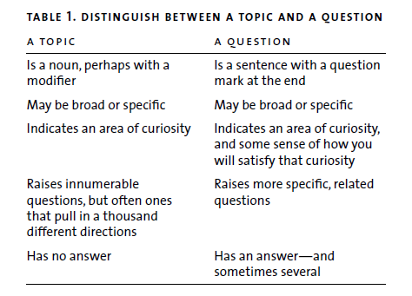
Note: Mullaney and Rea, p. 20

Slide 6
What is a Research Question?
Topics are not questions
A good question is sufficiently specific, open-ended, and at least a little personal
Danger zone: questions that seek to understand “causes” and “effects”

Slide 7
Why Start with Yourself?
Research begins by identifying personal passions and concerns.
Honest self-reflection leads to more meaningful and enduring questions.
Self-evidence: Pay attention to your instincts and curiosities as you explore your topic, refine your question, and do your research.​

Slide 8
Finding Your Problem in the Literature
A research problem disturbs or compels you (the personnel)
Problems can be empirical, theoretical, and/or normative (the so what?)
Avoid the “Narrow-Down-Your-Topic Trap” (pp. 21-22, Mulaney and Rea)
Strategies:
Read literature to identify gaps
Generate self-evidence about what draws or repels you in the readings
Visualize:
literature → questions → problem [DISCOVERY/READING]
Then:
question → problem → proposed solution [WRITING]

Slide 9
Let’s reflect
A topic
The literature
A problem
The question(s)
The solution(s) [data, methods, etc.] - later!

Slide 10
Overall structure
Introduction
Literature Review
Data and Sources / Analytical Framework
Findings
Conclusion and Discussion
YOU ARE HERE

Slide 11
Workshop: Self-Reflection and Brainstorming
On your laptop, tablet, or even phone…
Refer to Mullaney and Rea’s "Try This Now: Search Yourself" (pp. 27-28)
Identify from your initial proposals 2–3 topics of interest or questions and follow steps 2-7. Then answer the questions on p. 31. Keep in mind:
  Why does this matter to me?​
  Why might it matter to others?
Share

Slide 12
Stress-Test Your Questions
Are they clear, precise, and jargon-free?
Do they avoid leading, loaded, or causal language
(e.g., "How did X cause Y?“ OR “Why should X be like Y” OR “How should X do Y”)
Rewrite unclear or biased questions

Slide 13
First Exercise: Draft Your Research Problem
Revise/draft a research question and identify the research problem using the submitted proposal. Provide a brief explanation of the gap your research will address (tip of the literature review)
Aim for ~500 words that clearly state the WHAT (topic and question) and WHY (the “so what” that connects the question to bigger issues)

